Slide 1
Tree Traversals

Slide 2
Outline
Tree Traversals
Node Deletion in BST
Object-Oriented Programming
2

Slide 3
Tree Traversals
Tree is not a linear data structure like Linked List
In order to navigate through the tree a pattern or technique is required.
Tree Traversal is the process of visiting each node of the tree exactly once in a defined order
3

Slide 4
Tree Traversals
Breadth First Traversals
Depth First Traversals
4

Slide 5
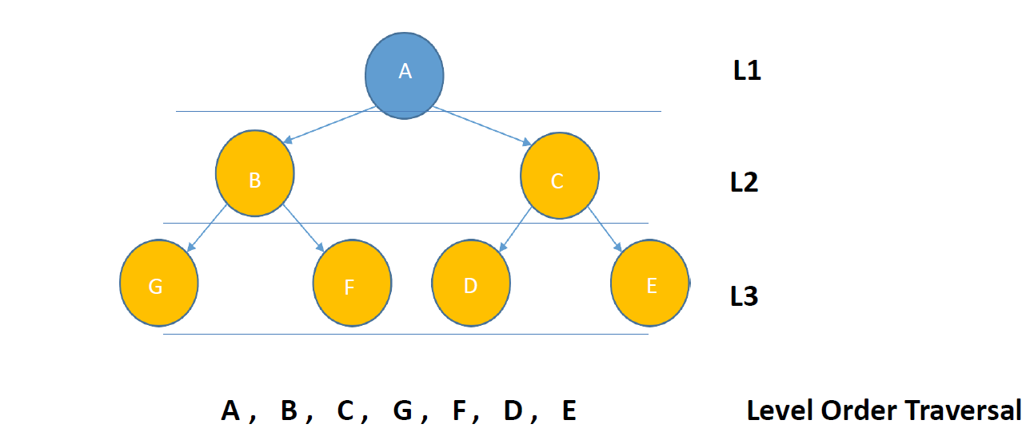
Breadth First Traversal
5

Slide 6
Breadth First Traversal
root
5
2
10
1
3
11
20
15
90
6

Slide 7
Breadth First Traversal
root
5
2
10
1
3
11
20
15
90
5
7

Slide 8
Breadth First Traversal
root
If (list is not empty)
current
5
2
10
1
3
11
20
15
90
5
8

Slide 9
Breadth First Traversal
root
If (list is not empty)
current
5
2
10
1
3
11
20
15
90
2
5
9

Slide 10
Breadth First Traversal
root
If (list is not empty)
current
5
2
10
1
3
11
20
15
90
2 | 10
5
10

Slide 11
Breadth First Traversal
root
If (list is not empty)
5
current
2
10
1
3
11
20
15
90
 | 10
5 2
11

Slide 12
Breadth First Traversal
root
If (list is not empty)
5
current
2
10
1
3
11
20
15
90
 | 10 | 1
5 2
12

Slide 13
Breadth First Traversal
root
If (list is not empty)
5
current
2
10
1
3
11
20
15
90
 | 10 | 1 | 3
5 2
13

Slide 14
Breadth First Traversal
root
If (list is not empty)
5
2
10
current
1
3
11
20
15
90
 |  | 1 | 3
5 2 10
14

Slide 15
Breadth First Traversal
root
If (list is not empty)
5
2
10
current
1
3
11
20
15
90
 |  | 1 | 3 | 11
5 2 10
15

Slide 16
Depth First Traversals
Pre-order
In-order
Post-order
16

Slide 17
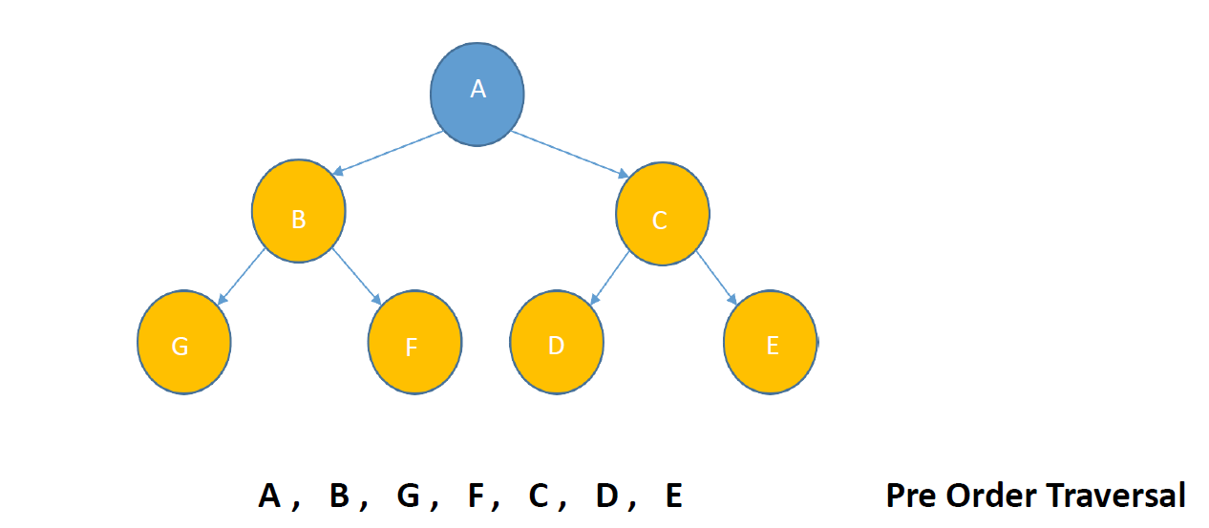
PreOrder Traversal <root><left><right>
17

Slide 18
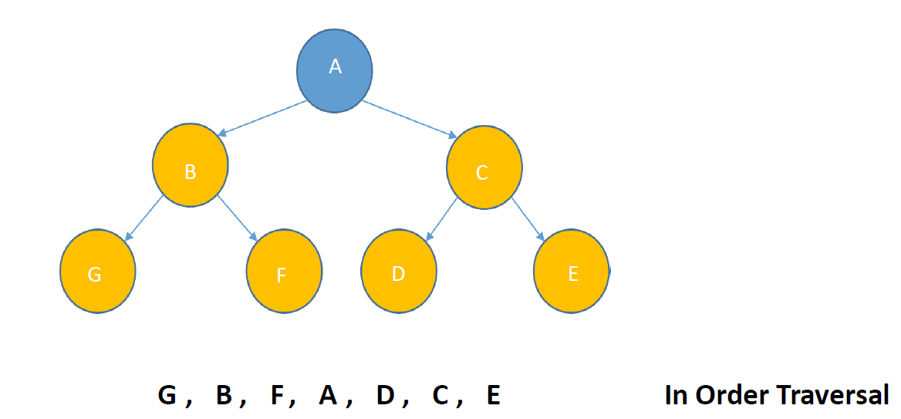
InOrder Traversal <left><root><right>
18

Slide 19
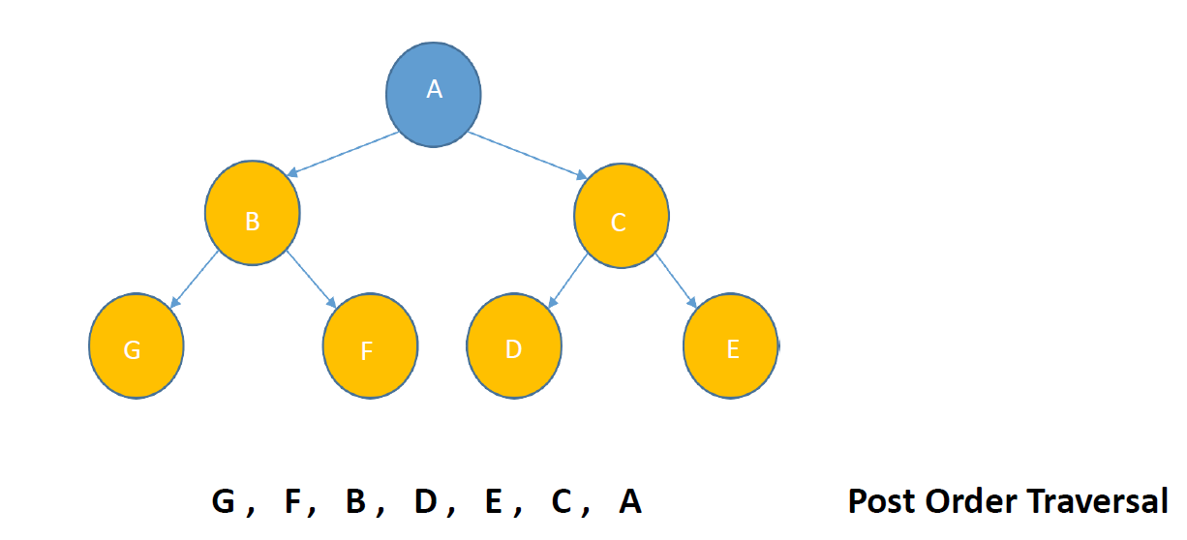
PostOrder Traversal <left><right><root>
19

Slide 20
Node Deletion in BST
root
parent
5
current
2
10
1
3
11
20
15
90
20

Slide 21
Node Deletion in BST
root
parent
5
current
2
10
1
3
11
20
15
90
21

Slide 22
Node Deletion in BST
root
5
parent
current
2
10
1
3
11
20
15
90
22

Slide 23
Node Deletion in BST
root
5
parent
2
10
1
3
11
current
20
15
90
23

Slide 24
Node Deletion in BST
root
5
parent
2
10
1
3
11
current
20
current.left = null
current.right = null
15
90
24

Slide 25
Node Deletion in BST
root
5
parent
2
10
null
3
11
current
20
15
90
25

Slide 26
Wrap-up
Tree Traversals
Node Deletion in BST
Object-Oriented Programming
26

